Slide 1
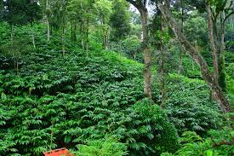
Environmental Impact Assessment of pesticide residues in cardamom cultivating area in Idukki district, Kerala
Ref No.KER-9_2017_83
Principal Investigator
Dr Bindumol G.P.
Executive Chemist
Ground Water Department, Kerala.

Slide 2
Particulars of the Project
Implementing Agency | Ground Water Department, Kerala
Name of PI | Dr Bindumol G. P.
Co-PIs | Smt. Savitha Balan, Dr. Sreekala M. S.
Project Associate | Smt. Neethu K. V
Budget (in lakhs) | 42.5
Date of Start | 01.09.2019 – Date of agreement for consultancy ( sanctioned on 3.4.2018)
Consultant | Indian Cardamom Research Institute, Spices Board, Govt. of India), Myladumpara, Idukki.

Slide 3
Background facts
Domains of Environment
Sources of water pollution
Small cardamom cultivation -CHR
Idukki - water resources rich district
Notes:
Lithosphere, Hydrosphere, atmosphere & Biosphere/ eg House construction -septic tanks-sewage pits-scientifically- Well -lawns-garden-fertiliser-fungicide-pesticides-glyphosate –weedicide- / Point & non point pollution./ Nitrate- vertical movemnet- mobile.---pollute water/ mosquito reppelelnt/

Slide 4
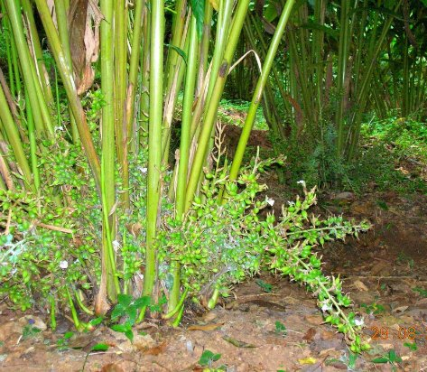
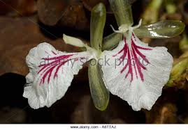
Cardamom is known as ‘Queen of Spices’
High Export potential
Major cardamom producers in India
Kerala – 70%
Karnataka – 20%
Tamil Nadu – 10%
Cultivates above 900-1200 m
Domestic Price/Kg- Rs. 2000/-
Idukki district is the major cardamom-producing area in Kerala.
Udumbanchola , Peermedu and Devikulam Taluk - Cardamom Cardamom Hill Reserve (CHR) of Idukki district.
Other pantation crops: Tea, black pepper, rubber, coffee, ginger, turmeric, nutmeg etc.
Notes:
Coming to cardamom, it known as Queen of Spices. It is a high value spice crop & having very good export potential. In India cardamom is cultivating in western ghat regions of Ker ,Kar& TN.
In Kerala, cardamom is cultivating in Peerumedu, udumbanchola & some parts of Devikulam taluk. As it grows well above 900 -1200m , major cardamom plantations are located in eastern side of Idukki district.

Slide 5
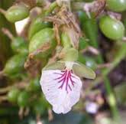
Production Statistics
Total area of cardamom cultivation in India: 69,870Ha
Area of cultivation in Kerala: 39,680 Ha
Total Production : 23,890 tonnes
Exported Quantity 2016-17 : 3,850 tonnes ( Rs.42,150 Lakh)
Export potential: Saudi Arabia, U.A.E., Kuwait, USA, Japan, Canada

Slide 6
Definition
Pesticide is defined as any substance intended for preventing, destroying, attracting, repelling or controlling pests including unwanted species of plants or animals during the production, storage, transportation, distribution or processing of food, agricultural commodities or animal feed, or which may be administered to animals for the control of ecto-parasites.
Pesticides include insecticides, fungicides, herbicides, nematicides etc.
.
Notes:
In early stages,

Slide 7
History of pesticides
Materials of natural origin: Plant materials, animal manures, dry ashes, soot, urine, sea water, soap, turpentine, etc.- Organic agriculture
Inorganic compounds: Paris Green, Bordeaux mixture, Borax etc.
Synthetic organic pesticides: DDT, HCH, Endosulfan etc.
Notes:
Tobacco extract, garlic paste etc/ cattle urine spary/ Based on chemical structure pesticides are classified into

Slide 8
Zone A
Peerumedu taluk excluding Kokkayar & Peruvanthanam villages, Chakkupallam, Ayyappankovil and Vandenmedu villages of Udumbanchola, which come about 34% of Cardamom Hill Reserve (CHR).
Zone B
Chathurangappara, Rajakkad, Santhanpara, Pampadumpara, Parathode, Udumbanchola villages of UdumbancholaTaluk, which covers 43% of CHR.
Rest of the cardamom growing area including kanniyalam tract in low lying area are come under zone C.

Slide 9
Classification of Pesticides Chemical structure/ Mode of action
Organochlorines: DDT, Lindane, Aldrin, Endrin, Dieldrin, Endosulphan etc.
Organophosphates: Dimethoate, Phorate, Monocrotophos, Triazophos, Chlorpyriphos, Quinalphos etc.
Carbamates: Carbaryl, Carbofuran, Methomyl, Pirimicarb etc.
Synthetic Pyrethroids: Lambda Cyhalothrin, Cypermethrin, Fenvalerate, Deltamethrin, Fenpopathrin etc.
Neonicotinoides: Imidacloprid, Acetamiprid etc.
Phenyl pyrazoles: Fipronil
Benzoyl ureas: Triflumuron, Chlorfluazuron, Novaluron etc.
Notes:
DDT is the 1st synthetic organic pesticide. Initially it has been used in healthcare sector and then to agricultural purpose. Due to high mammalian toxicity and environmental persistence most of the OC either banned or restricted for use in agriculture.
OP are most versatile group of pesticides including aliphatic & alicyclic compounds. They are highly effective and requires relatively less quantity/unit area.
Carbamates are much toxic chemicals. Mode of action of OP and carbamates are similar ie, inhibits acetyl choline esterase.
SPs have rapid knock-down action and low mammalian toxicity and environmental persistence.

Slide 10
WHO Classification of the Insecticides-
Catagory | LD50 value (mg/Kg) | Colour
1.Extremely toxic | 1-50 | Bright red
2. Highly toxic | 51-500 | Bright yellow
3. Moderately toxic | 501-5000 | Bright blue
4. Slightly toxic | More than 5000 | Bright Green

Slide 11
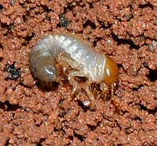
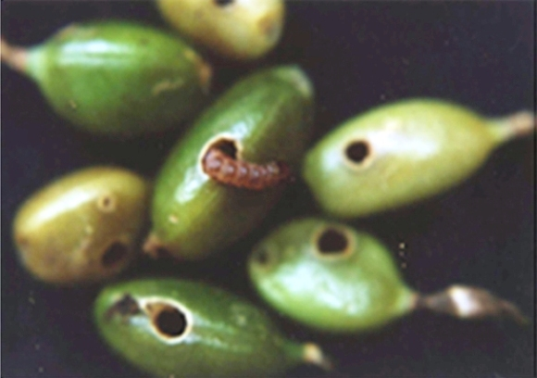
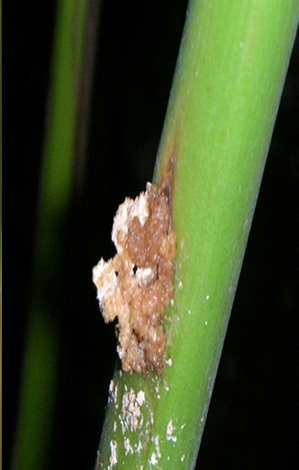
Major Pests of cardamom plantation
Root grub
Nursery pests
Root grub, Shoot borer, Shoot fly
Plantation pests
Cardamom thrips, shoot / panicle / capsule borer, root grub, root knot nematodes, cardamom white fly and hairy caterpillars.
Root grub Beetle
Capsule borer
Shoot borer
Notes:
Since cardamom is cultivating under forest shade, it is being attacked by a lot of insect pests from nursery stage.

Slide 12
Pesticides available in market for the use of pest & disease control in cardamom plantation
Chlorantraniliprole |  | Cypermethrin | Emamectin benzoate
Quinalphos |  | Imidachloprid | Thiamethoxam
Acephate |  | Acetamiprid | Metalaxyl
Ethion |  | Fipronil | Cymoxanil
Triazophos |  | Mancozeb | Carbendazim
Chlorpyriphos |  | Fosetyl-Al
Profenophos |  | COC
Phenthoate |  | Thiophanate-methyl
Omethoate |  | Hexaconazole
Monocrotophos
Lambda-cyhalothrin |  | Daifenthiuron
Bifentrin |  | Flubendiamide
Notes:
30 compounds

Slide 13
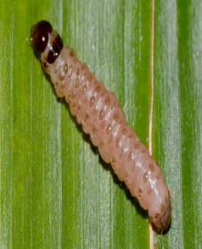
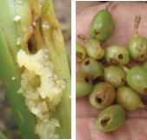
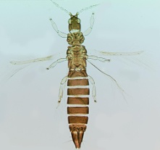
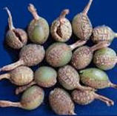
Spray schedule of Quinalphos
Thrips - March to May & August to September
shoot/panicle/capsule borer- January-February, September-October
Broad spectrum systemic pesticide.
Quinalphos : Foliar spary (@0.025%
Thrips
Notes:
Thrips feed on immature capsules and resulted in malformed capsules and thus affect export potential.
Similarly -Shoot borer feeds shoot/Panicle/capsules and damages the crop.
For controlling these pest quinalphos is sprayed during March-may/ August –sept,

Slide 14
mapS

Slide 15
OBJECTIVES
1. Monitoring of pesticide residues in ground water bodies located in cardamom plantations and study the soil physical and hydraulic properties of that locations.
2. Conduct unsaturated soil column studies under controlled and field conditions using lysimeter to study the mobility of different classes of pesticides through the soil and confirmation of the findings by isotope technology.
3.Mathematical modeling of solute (pesticide) transport in ground water can be developed based on the soil physico- chemical properties and solute transport.

Slide 16
Zone A
Peerumedu taluk excluding Kokkayar & Peruvanthanam villages, Chakkupallam, Ayyappankovil and Vandenmedu villages of Udumbanchola, which come about 34% of Cardamom Hill Reserve (CHR).
Zone B
Chathurangappara, Rajakkad, Santhanpara, Pampadumpara, Parathode, Udumbanchola villages of UdumbancholaTaluk, which covers 43% of CHR.
Rest of the cardamom growing area including kanniyelam tract in low lying area are come under zone C.

Slide 17
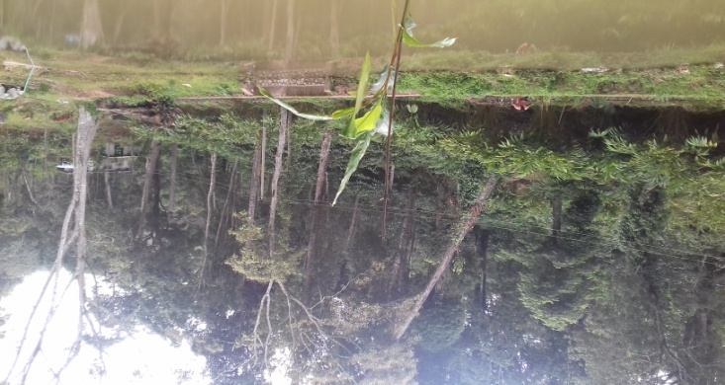
OBJECTIVE-1
Temporospatial changes in water quality and residues of agro-chemicals which may pollutes ground water sources in CHR.
Notes:
Spacial distribution of pollutants- Hurdles in the PDS study. Identification of cardamom plantation- no owners- source identification
Spices baord development wing offices in Idukki helped us.
Idukki-prestine water souces-ariculral pollutants. No major industries.

Slide 18
Major data being collected
Water quality data of open wells, bore wells and streams located in cardamom hill reserve for
pH, EC, TDS, turbidity, Total Hardness, Calcium content, magnesium content, Total Alkalinity, carbonates, bicarbonate, chloride, nitrate-N, and sulphate content.
Pesticide residues of following molecules:
Organochlorines
α-BHC,Heptachlor,α- Chlordane,Endrin,4,4’- DDT,γ- BHC,Aldrin,Endosulfan-1,4,4’- DDD, Endosulfan sulfate, Β- BHC,Heptachlor epoxide,4,4’- DDE, Endosulfan-II, Methoxychlor, δ- BHC,γ- Chlordane,Dieldrin,Endrin aldehyde, &Endrin ketone in GC- ECD
Organophosphates
Malathion , Chlorpyrifos , Quinalphos , Phenthoate , Ethion , Acephate and Omethoate in GC -FPD
Synthetic Pyrethroids: Lambda-cyhalothrin, bifenthrin- GC -ECD
10% of the samples detected with residue are confirmed the results in gas chromatograph using LC-MSMS.

Slide 19
WORK PLAN AND ACTIVITY
Sampling locations were identified from cardamom cultivating area of CHR
Altogether 25 open wells, 11 bore wells and 14streams have been identified for periodical monitoring.
Apart from above sources, water samples were collected randomly from 150 water sources in CHR.
Samples were analysed for physico-chemical and pesticide residues.
Data generated were compiled.
Residue detected samples are being undergone confirmation analysis using GCMS/LCMS.

Slide 20
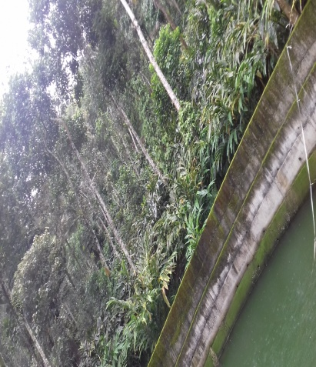
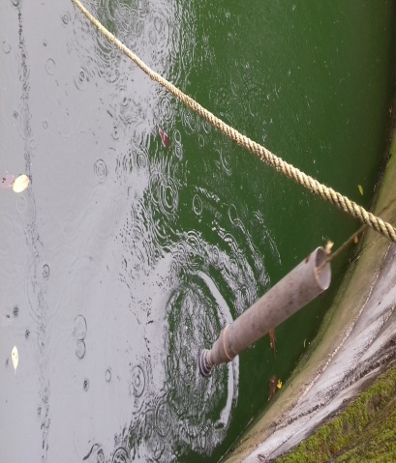
ANALYTICAL RESULTS
Physico-Chemical parameters of open well samples
Well ID | pH | EC (µS/cm) | TDS (mg/L) | TH (mgCaCO3/L) | Ca (mg/L) | Mg (mg/L) | Na (mg/L) | K(mg/L) | CO₃²⁻ (mg/L) | H CO₃⁻ (mg/L) | TA (mgCaCO3/L) | Cl⁻ (mg/L) | Nitrate N(mg/L) | ƛ-220 | ƛ-275
OW 1 | 6.1 | 107 | 64 | 40 | 10 | 3.7 | 3.9 | 1.9 | 0 | 22 | 18 | 11 | 6.82 | 1.832 | 0.009
OW 2 | 5.2 | 63 | 38 | 25 | 4 | 3.7 | 3.1 | 1 | 0 | 24.4 | 20 | 8 | ND | 0.096 | 0.077
OW3 | 6.4 | 70 | 42 | 30 | 6 | 3.6 | 4.3 | 2.4 | 0 | 22 | 18 | 13 | 0.56 | 0.217 | 0.034
OW4 | 6.9 | 129 | 77 | 60 | 10 | 8.5 | 6.9 | 2.8 | 0 | 22 | 18 | 14 | 5.47 | 1.49 | 0.015
OW5 | 6 | 136 | 82 | 55 | 16 | 3.7 | 7.1 | 2.1 | 0 | 22 | 18 | 9 | 0.06 | 0.32 | 0.15
OW6 | 5.1 | 62 | 37 | 20 | 6 | 1.2 | 4 | 1.7 | 0 | 12.2 | 10 | 9 | 1.53 | 0.66 | 0.127
OW7 | 5.4 | 82 | 49 | 35 | 8 | 3.7 | 3.7 | 1.1 | 0 | 7.3 | 6 | 14 | 2.41 | 0.8 | 0.08
OW8 | 6.3 | 138 | 83 | 50 | 8 | 7.3 | 8.4 | 3.2 | 0 | 17.1 | 14 | 22 | 4.18 | 1.16 | 0.02
OW9 | 7 | 194 | 116 | 75 | 14 | 9.8 | 8.5 | 6.4 | 0 | 48.8 | 40 | 21 | 2.81 | 0.82 | 0.002
OW10 | 6.6 | 130 | 78 | 50 | 10 | 6.1 | 8.3 | 3.7 | 0 | 29 | 24 | 18 | 3.01 | 0.82 | 0.01
OW11 | 6.6 | 150 | 90 | 70 | 16 | 7.3 | 8.1 | 4.3 | 0 | 41 | 34 | 20 | 3.66 | 1.02 | 0.027
OW12 | 7.2 | 290 | 174 | 80 | 28 | 2.4 | 28.1 | 1.8 | 0 | 59 | 48 | 33 | 11.13 | 2.98 | 0.01
OW13 | 5.7 | 65 | 39 | 30 | 6 | 3.7 | 3.8 | 2.5 | 0 | 19.5 | 16 | 10 | 1.38 | 0.39 | 0.008
MEAN | 6.19 | 124.31 | 74.54 | 47.69 | 10.92 | 4.98 | 7.55 | 2.68 | 0.00 | 26.64 | 21.85 | 15.54 | 3.59 | 0.97 | 0.04
MIN | 5.1 | 62 | 37 | 20 | 4 | 1.2 | 3.1 | 1 | 0 | 7.3 | 6 | 8 | 0.06 | 0.096 | 0.002
MAX | 7.2 | 290 | 174 | 80 | 28 | 9.8 | 28.1 | 6.4 | 0 | 59 | 48 | 33 | 11.13 | 2.98 | 0.15

Slide 21
Physico –chemical parameters of the samples collected during October
Well ID | pH | EC | TDS | TH | Ca | Mg | Na | K | CO₃²⁻ | H CO₃⁻ | TA | Cl- | Nitrate N | ƛ-220 | ƛ-275
OW 1 | 5.8 | 90 | 54 | 45 | 10 | 4.9 | 4.5 | 1.7 | 0 | 34 | 28 | 10 | 0.8 | 0.227 | 0.008
OW 2 | 5.2 | 57 | 34 | 25 | 6 | 2.4 | 4.5 | 1.2 | 0 | 24.4 | 20 | 7 | 0.01 | 0.027 | 0.012
OW3 | 5.3 | 73 | 44 | 20 | 4 | 2.4 | 7.1 | 3.1 | 0 | 22 | 18 | 14 | 0.01 | 0.039 | 0.019
OW4 | 5.6 | 74 | 44 | 25 | 8 | 1.2 | 5.6 | 1.4 | 0 | 22 | 18 | 10 | 1.2 | 0.357 | 0.019
OW5 | 6.7 | 75 | 45 | 25 | 6 | 2.4 | 6.9 | 1.8 | 0 | 12.2 | 10 | 16 | 1.74 | 0.493 | 0.015
OW6 | 4.9 | 70 | 42 | 35 | 6 | 4.9 | 3.7 | 1.8 | 0 | 12.2 | 10 | 9 | 3.3 | 0.897 | 0.01
OW8 | 5.4 | 126 | 76 | 45 | 10 | 4.9 | 8.3 | 2.3 | 0 | 19.5 | 16 | 22 | 3.1 | 0.862 | 0.019
OW10 | 5.5 | 145 | 87 | 50 | 10 | 6.1 | 8.8 | 3.6 | 0 | 44 | 36 | 19 | 3.22 | 0.869 | 0.012
OW11 | 6.7 | 137 | 82 | 55 | 12 | 6.1 | 9.6 | 3.5 | 0 | 41 | 34 | 20 | 1.59 | 0.465 | 0.02
OW12 | 5.9 | 390 | 234 | 105 | 30 | 7.3 | 37.4 | 1.7 | 0 | 68 | 56 | 46
OW13 | 5.3 | 58 | 35 | 20 | 4 | 2.4 | 3.2 | 2.6 | 0 | 17 | 14 | 8 | 1.02 | 0.285 | 0.006
OW14 | 6.2 | 88 | 53 | 35 | 8 | 2.4 | 6.3 | 1.7 | 0 | 17 | 14 | 14 | 2.28 | 0.626 | 0.01
OW15 | 5.1 | 184 | 110 | 55 | 12 | 6.1 | 11.9 | 5.7 | 0 | 14.6 | 12 | 30
OW16 | 6.1 | 124 | 74 | 45 | 12 | 3.7 | 6.5 | 4 | 0 | 41 | 34 | 21 | 0.17 | 0.172 | 0.064
OW17 | 5.1 | 103 | 62 | 30 | 12 | 1.2 | 6.8 | 1.8 | 0 | 12.2 | 10 | 12 | 5 | 1.338 | 0.004
MEAN | 5.65 | 119.60 | 71.73 | 41.00 | 10.00 | 3.89 | 8.74 | 2.53 | 0.00 | 26.74 | 22.00 | 17.20 | 1.80 | 0.51 | 0.02
MIN | 4.90 | 57.00 | 34.00 | 20.00 | 4.00 | 1.20 | 3.20 | 1.20 | 0.00 | 12.20 | 10.00 | 7.00 | 0.01 | 0.03 | 0.00
MAX | 6.70 | 390.00 | 234.00 | 105.00 | 30.00 | 7.30 | 37.40 | 5.70 | 0.00 | 68.00 | 56.00 | 46.00 | 5.00 | 1.34 | 0.06

Slide 22
Physico –chemical parameters of the samples collected during December
Well ID | pH | EC (µS/cm) | TDS (mg/L) | TH (mgCaCO3/L) | Ca (mg/L) | Mg (mg/L) | Na (mg/L) | K(mg/L) | CO₃²⁻ (mg/L) | H CO₃⁻ (mg/L) | TA (mgCaCO3/L) | Cl⁻ (mg/L) | SO₄²⁻ | Nitrate N(mg/L)
MEAN | 6.85 | 136.3 | 81.74 | 39.47 | 9.95 | 5.52 | 9.83 | 2.58 | 0.88 | 33.47 | 28.95 | 19.42 | 1.54 | 2.00
min | 5.4 | 59 | 35 | 15 | 4 | 0 | 3.6 | 0.6 | 0 | 7.3 | 12 | 5 | 0 | 0
max | 8.3 | 470 | 282 | 60 | 35 | 20.7 | 42.7 | 8.9 | 9.6 | 75.6 | 62 | 63 | 9.1 | 8.85
PESTICIDE SPRY IN CARDAMOM PLANTATION

Slide 23
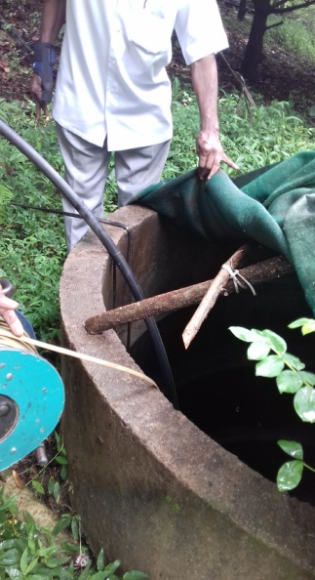
Physico-chemical characteristics of Bore well samples
Aug-19
Well ID | pH | EC | TDS | TH | Ca | Mg | Na | K | CO3 | HCO3 | TA | Cl | Nitrate N | ƛ-220 | ƛ-275
BW1 | 6.8 | 260 | 156 | 135 | 32 | 13.4 | 8.1 | 2.5 | 0 | 159 | 130 | 13 | 0.14 | 0.06 | 0.014
BW2 | 8.3 | 260 | 156 | 35 | 14 | 0 | 12.2 | 3.1 | 9.6 | 142 | 132 | 8 | 0.01 | 0.24 | 0.21
BW3 | 8.3 | 270 | 162 | 55 | 18 | 2.4 | 41.5 | 1.6 | 9.6 | 110 | 106 | 20 | 2.01 | 0.06 | 0.007
BW4 | 8.3 | 430 | 258 | 200 | 16 | 63 | 12.4 | 2.8 | 12 | 146 | 140 | 21 | 0.002 | 0.13 | 0.015
BW5 | 6.4 | 310 | 186 | 25 | 6 | 2.4 | 3.8 | 0.3 | 0 | 54 | 44 | 43 | 9.317 | 2.52 | 0.019
MEAN | 7.62 | 306 | 183.6 | 90 | 17.2 | 16.24 | 15.6 | 2.06 | 6.24 | 122.2 | 110.4 | 21 | 2.30 | 0.60 | 0.05
Oct-19
Well ID | pH | EC | TDS | TH | Ca | Mg | Na | K | CO3 | HCO3 | TA | Cl | Nitrate N | ƛ-220 | ƛ-275
BW1 | 6.4 | 270 | 162 | 155 | 36 | 15.9 | 8.2 | 2.2 | 0 | 166 | 136 | 12 | 0.3 | 0.111 | 0.016
BW3 | 6.8 | 137 | 82 | 50 | 10 | 6.1 | 10.8 | 1.4 | 0 | 32 | 26 | 20 | 2.32 | 0.641 | 0.012
BW4 | 7.2 | 400 | 240 | 220 | 32 | 34.2 | 17.5 | 2.4 | 0 | 276 | 226 | 20 | 0.02 | 0.031 | 0.013
MEAN | 7 | 269 | 161 | 142 | 26 | 19 | 12 | 2 | 0 | 158 | 129 | 17 | 1 | 0 | 0
Dec-19
Well ID | pH | EC | TDS | TH | Ca | Mg | Na | K | CO3 | HCO3 | TA | Cl | SO4 | NO3
BW8 | 6.2 | 390 | 234 | 165 | 42 | 14.6 | 9 | 2.7 | 0 | 181 | 148 | 34 | 3.9 | 0
BW7 | 8.3 | 310 | 186 | 135 | 26 | 17.1 | 22.6 | 2.2 | 14.4 | 127 | 128 | 10 | 27.3 | 0.27
BW-6 | 8.3 | 300 | 180 | 100 | 26 | 8.5 | 16.6 | 3.8 | 7.2 | 76 | 24 | 24 | 17.3 | 6.7
BW-8 | 6.9 | 330 | 198 | 160 | 28 | 22 | 9.7 | 5.5 | 0 | 193 | 158 | 3 | 18 | 0
BW9 | 5.8 | 57 | 34 | 20 | 4 | 2.4 | 4.1 | 2.3 | 0 | 22 | 18 | 7 | 0 | 1.43
BW-1 | 6.7 | 280 | 168 | 140 | 48 | 14.6 | 7.9 | 2.5 | 0 | 159 | 130 | 13 | 0.2 | 0.21
MEAN | 7.03 | 277.83 | 166.67 | 120.00 | 29.00 | 13.20 | 11.65 | 3.17 | 3.60 | 126.33 | 101.00 | 15.17 | 11.12 | 1.44
OPEN WELL SAMPLING

Slide 24
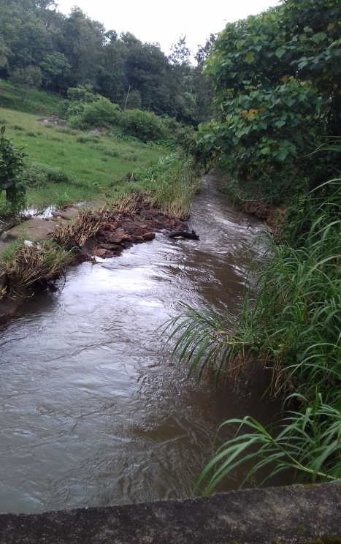
Physico-chemical characteristics of stream samples (August)
Well ID | pH | EC | TDS | TH | Ca | Mg | Na | K | CO3 | HCO3 | TA | Cl | Nitrate N | ƛ-220 | ƛ-275
S1 | 6.4 | 55 | 33 | 25 | 6 | 2.4 | 2.9 | 1 | 0 | 22 | 18 | 7 | 0.8 | 0.23 | 0.008
S2 | 6.7 | 79 | 47 | 35 | 4 | 6.1 | 3.2 | 1.5 | 0 | 17.1 | 14 | 10 | 2.39 | 0.69 | 0.027
S3 | 7.0 | 67 | 40 | 40 | 6 | 6.1 | 4.9 | 1.2 | 0 | 22 | 18 | 9 | 0.86 | 0.27 | 0.019
S4 | 6.8 | 45 | 27 | 15 | 4 | 1.2 | 3.6 | 0.4 | 0 | 19.5 | 16 | 6 | 0.24 | 0.12 | 0.027
S5 | 5.5 | 84 | 50 | 25 | 6 | 2.4 | 6.2 | 3 | 0 | 29.3 | 24 | 14 | 0.02 | 0.38 | 0.185
S6 | 6.8 | 124 | 74 | 55 | 8 | 8.5 | 6.2 | 4.1 | 0 | 19.5 | 16 | 19 | 3.3 | 0.92 | 0.019
S7 | 7.0 | 99 | 59 | 40 | 6 | 6.1 | 7 | 1.4 | 0 | 24.4 | 20 | 16 | 1.21 | 0.36 | 0.019
S8 | 6.5 | 153 | 92 | 45 | 12 | 3.7 | 10 | 4.3 | 0 | 26.8 | 22 | 27 | 1.82 | 0.59 | 0.052
MEAN | 6.6 | 88.3 | 52.8 | 35.0 | 6.5 | 4.6 | 5.5 | 2.1 | 0.0 | 22.6 | 18.5 | 13.5 | 1.3 | 0.4 | 0.0
min | 5.5 | 45.0 | 27.0 | 15.0 | 4.0 | 1.2 | 2.9 | 0.4 | 0.0 | 17.1 | 14.0 | 6.0 | 0.0 | 0.1 | 0.0
max | 7.0 | 153.0 | 92.0 | 55.0 | 12.0 | 8.5 | 10.0 | 4.3 | 0.0 | 29.3 | 24.0 | 27.0 | 3.3 | 0.9 | 0.2

Slide 25
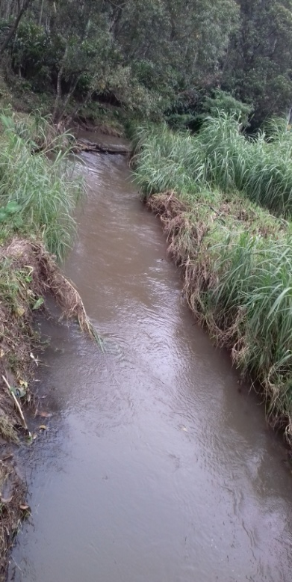
Physico-chemical characteristics of stream samples (October )
Well ID | pH | EC | TDS | TH | Ca | Mg | Na | K | CO3 | HCO3 | TA | Cl | Nitrate N | ƛ-220 | ƛ-275 | Nitrate N | ƛ-220 | ƛ-275
S1 | 5.7 | 53 | 32 | 20 | 2 | 3.7 | 4.3 | 1.2 | 0 | 22 | 18 | 6 | 0.002 | 0.024 | 0.12 | 0.002 | 0.024 | 0.12
S2 | 6.2 | 73 | 44 | 35 | 4 | 6.1 | 5 | 1.6 | 0 | 22 | 18 | 11 | 0.61 | 0.264 | 0.05 | 0.61 | 0.264 | 0.05
S3 | 6.3 | 68 | 41 | 25 | 6 | 2.4 | 5.6 | 1 | 0 | 27 | 22 | 9 | 0.09 | 0.107 | 0.042 | 0.09 | 0.107 | 0.042
S4 | 7 | 61 | 36 | 30 | 2 | 6.1 | 4.3 | 1 | 0 | 19.5 | 16 | 11 | 0.19 | 0.163 | 0.057 | 0.19 | 0.163 | 0.057
S8 | 6 | 134 | 80 | 40 | 8 | 4.9 | 8.8 | 4 | 0 | 19.5 | 16 | 21 | 3.23 | 0.944 | 0.042 | 3.23 | 0.944 | 0.042
S9 | 6.6 | 112 | 67 | 40 | 8 | 4.9 | 5.6 | 3.7 | 0 | 22 | 18 | 17 | 2.4 | 0.708 | 0.035 | 2.4 | 0.708 | 0.035
MEAN | 6.3 | 83.5 | 50.0 | 31.7 | 5.0 | 4.7 | 5.6 | 2.1 | 0.0 | 22.0 | 18.0 | 12.5 | 1.1 | 0.4 | 0.1 | 1.1 | 0.4 | 0.1
min | 5.7 | 53 | 32 | 20 | 2 | 2.4 | 4.3 | 1 | 0 | 19.5 | 16 | 6 | 0.002 | 0.024 | 0.035 | 0.002 | 0.024 | 0.035
max | 7 | 134 | 80 | 40 | 8 | 6.1 | 8.8 | 4 | 0 | 27 | 22 | 21 | 3.23 | 0.944 | 0.12 | 3.23 | 0.944 | 0.12

Slide 26
Physico-chemical characteristics of stream samples (December)
Well ID | pH | EC | TDS | TH | Ca | Mg | Na | K | CO3 | HCO3 | TA | Cl | SO4 | NO3-N
S-12 | 5.9 | 111 | 66 | 30 | 8 | 2.4 | 6.7 | 2.7 | 0 | 24.4 | 20 | 15 | 2.3 | 0.3
S13 | 8.3 | 136 | 82 | 60 | 16 | 4.9 | 7.3 | 1.8 | 0 | 51 | 50 | 14 | 3.6 | 0.54
S-11 | 7.3 | 107 | 64 | 40 | 8 | 4.9 | 5.5 | 2.6 | 0 | 24.4 | 20 | 16 | 3.2 | 2.1
S-10 | 8.4 | 111 | 66 | 40 | 8 | 4.9 | 6.2 | 3.8 | 2.4 | 14.6 | 16 | 14 | 4.8 | 2.7
S-3 | 7.4 | 79 | 47 | 30 | 6 | 3.7 | 6.8 | 1.1 | 0 | 32 | 26 | 10 | 0.94 | 0.45
S-1 | 5.7 | 62 | 37 | 30 | 4 | 4.9 | 4.5 | 1.3 | 0 | 27 | 22 | 6 | 1.7 | 0.03
S-15 | 6.6 | 79 | 47 | 30 | 6 | 3.7 | 4.9 | 2.1 | 0 | 39 | 32 | 8 | 0.9 | 0.22
S-2 | 8.3 | 83 | 50 | 55 | 55 | 8.5 | 5.1 | 1.4 | 7.2 | 98 | 20 | 12 | 2.3 | 0.93
S-4 | 7.4 | 76 | 46 | 30 | 8 | 2.4 | 5.4 | 1.1 | 0 | 32 | 26 | 12 | 0.4 | 0.6
S-14 | 8.4 | 78 | 47 | 45 | 20 | 1.2 | 6.3 | 1.6 | 4.8 | 17.1 | 22 | 12 | 4.2 | 0.28
S-8 | 8.3 | 140 | 84 | 35 | 10 | 2.4 | 9.7 | 4 | 4.8 | 17.1 | 22 | 23 | 0.8 | 3.2
S-9 | 6.9 | 131 | 73 | 60 | 8 | 9.8 | 6.3 | 3.8 | 0 | 29 | 24 | 19 | 1.9 | 2.5
MEAN | 7.4 | 99.4 | 59.1 | 40.4 | 13.1 | 4.5 | 6.2 | 2.3 | 1.6 | 33.8 | 25.0 | 13.4 | 2.3 | 1.2
min | 5.7 | 62.0 | 37.0 | 30.0 | 4.0 | 1.2 | 4.5 | 1.1 | 0.0 | 14.6 | 16.0 | 6.0 | 0.4 | 0.0
max | 8.4 | 140.0 | 84.0 | 60.0 | 55.0 | 9.8 | 9.7 | 4.0 | 7.2 | 98.0 | 50.0 | 23.0 | 4.8 | 3.2

Slide 27
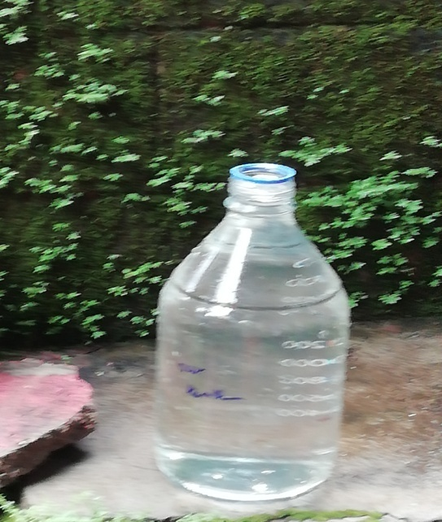
Statistical Analysis of pH of different water sources
Correlations
 |  | pH ow | pH BW | pH S
pH ow | Pearson Correlation | 1 | .247 | -.025
 | Sig. (2-tailed) |  | .395 | .904
 | N | 47 | 14 | 26
pH BW | Pearson Correlation | .247 | 1 | .392
 | Sig. (2-tailed) | .395 |  | .165
 | N | 14 | 14 | 14
pH S | Pearson Correlation | -.025 | .392 | 1
 | Sig. (2-tailed) | .904 | .165
 | N | 26 | 14 | 26
Correlations were not obtained in pH value of various water sources

Slide 28
Statistical Analysis of Total Dissolved Solids of different water sources
Correlations
 |  | TDSow | TDSbw | TDSst
TDSow | Pearson Correlation | 1 | .345 | -.232
 | Sig. (2-tailed) |  | .190 | .235
 | N | 47 | 16 | 28
TDSbw | Pearson Correlation | .345 | 1 | -.481
 | Sig. (2-tailed) | .190 |  | .060
 | N | 16 | 16 | 16
TDSst | Pearson Correlation | -.232 | -.481 | 1
 | Sig. (2-tailed) | .235 | .060
 | N | 28 | 16 | 28

Slide 29
Statistical Analysis of Nitrate-N content of different water sources
Correlations
 |  | NO3 N OW | NO3 N BW | NO3 N St
NO3 NOW | Pearson Correlation | 1 | -.024 | -.309
 | Sig. (2-tailed) |  | .935 | .124
 | N | 48 | 14 | 26
NO3 NBW | Pearson Correlation | -.024 | 1 | .576*
 | Sig. (2-tailed) | .935 |  | .031
 | N | 14 | 14 | 14
NO3 NSt | Pearson Correlation | -.309 | .576* | 1
 | Sig. (2-tailed) | .124 | .031
 | N | 26 | 14 | 26
*. Correlation is significant at the 0.05 level (2-tailed).

Slide 30
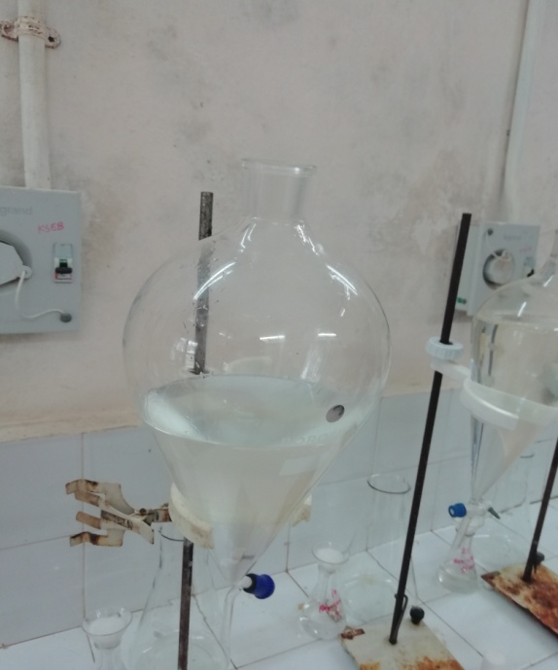
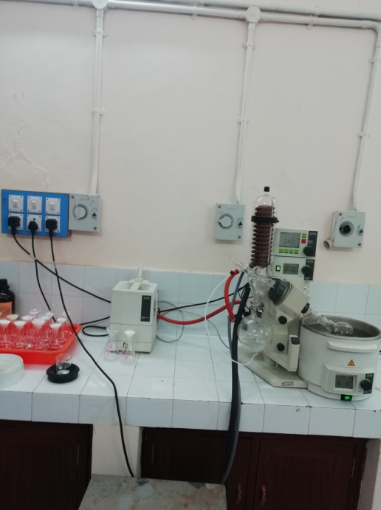
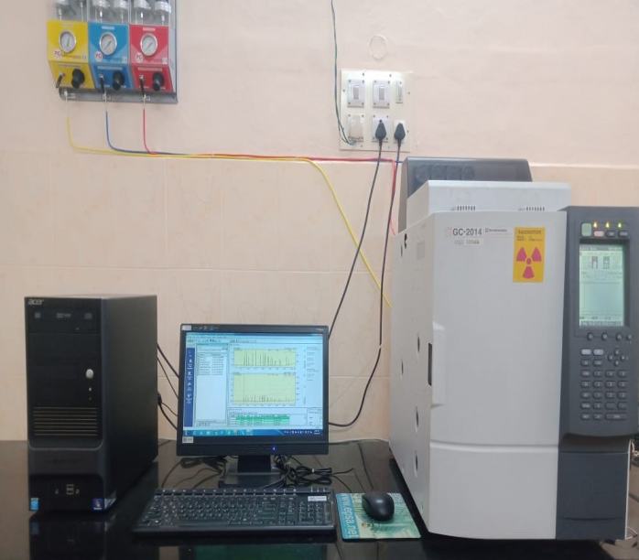
Liquid-liquid extraction method used for the extraction of pesticide residues from water samples at ng/L level.
^{Water sample (1L)}
^{Liquid-liquid extraction}
water +NaCl (100g) in 2L capacity separatory funnel
Extraction with solvent mixture
(Dichloromethane : Hexane ( 15:85 v/v) thrice
Concentrate on rotary vacuum evaporator to 2mL
GLC analysis (OC/OP/SP)(Detection limit = 10ng)

Slide 31
Name of organochlorine pesticides analysed
α-BHC | Heptachlor | α- Chlordane | Endrin | 4,4’- DDT
γ- BHC | Aldrin | Endosulfan-1 | 4,4’- DDD | Endosulfan sulfate
Β- BHC | Heptachlor epoxide | 4,4’- DDE | Endosulfan-II | Methoxychlor
δ- BHC | γ- Chlordane | Dieldrin | Endrin aldehyde | Endrin ketone

Slide 32
Name of organophosphate pesticides analysed
Name | Retention Time(min)
Malathion 14.505
Chlorpyrifos 14.762
Quinalphos 15.665
Phenthoate 15.65
Ethion 17.47
Acephate 19.731
Omethoate 19.8
Agrochemical shop at Nedumkandam

Slide 33
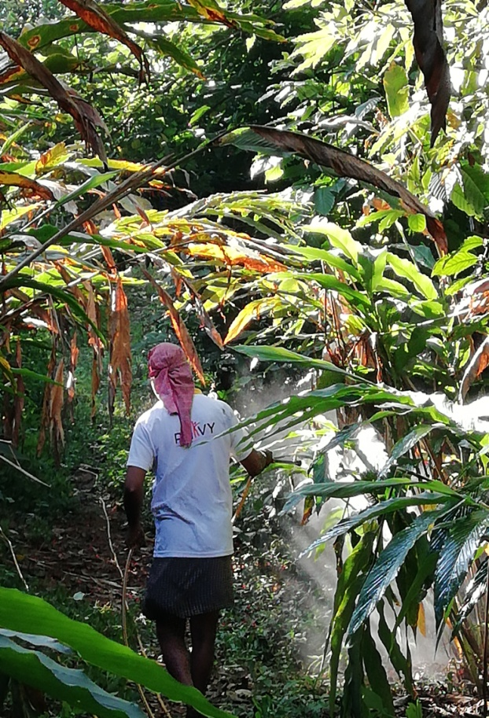
Chromatogram of OP pesticides (CRM)

Slide 34
Open well- Confirmation in LCMS needed

Slide 35
Chromatogram of samples from Stream

Slide 36
Chromatogram of OC std

Slide 37
OC pesticides detected- Confirmation in GCMS required

Slide 38
ANALYTICAL RESULTS OF IN LCMSMS
Sl No. | Name of Pesticides (ug/L)-2019 | Stream (Anakkara ) | OW (Parathode) | BW (Karithode )
1 | Metalaxyl | 0.00813 | 0.02062 | 0.00754
2 | Carbendazim | 0.000932 | 0.00306 | BDL
3 | Triazophos | 0.001476 | 0.001508 | 0.02154
4 | Ethion | 0.1627 | 0.00088 | 0.00227
5 | Profenophos | 0.00449 | 0.00251 | 0.1387
6 | Chlorpyrifos | 0.309 | 2.51 | 0.0685
7 | Chlorpyrifos methyl | 0.305 | 2.4 | BDL
8 | Bifenthrin | 0.0303 | BDL | 0.0182
9 | Buprafeacin | 0.001032 | 0.001816 | 0.000946
10 | Lamda Cyhalothrin | 0.0549 | BDL | BDL
11 | Monocrotophos | 0.001144 | BDL | BDL
12 | Phenthoate | 0.01022 | 0.0387 | 0.0336
12 | Malathion | BDL | 0.01299 | BDL
13 | Difinconazole | BDL | 0.00241 | 0.00685
14 | Propiconazole | BDL | BDL | 0.00749
15 | Fenithrothion | BDL | BDL | 0.1301
16 | BHC alpha | 0.0099098 | 0.0004808 | 0.0100816
17 | BHC beta | 0.0100074 | 0.000486 | 0.0094408
18 | BHC delta | 0.0100126 | 0.0003082 | 0.0095836
19 | BHC gama | BDL | 0.0103476 | BDL
20 | Endosulfan I | 0.0072632 | BDL | BDL
21 | Endosulfan Sulphate | 0.2410396 | 0.024698 | 0.2341622
Data analysis and results of field/laboratory investigations and computer simulations etc.

Slide 39
List of pesticides confirmed by LCMSMS Altogether 60 pesticide molecules extensively used for spice cultivation have been analysed based on abundance of two major ions
Sl No. | Organophosphates | Synthetic pyrethroids | Carbamates | Neonicotinoid | Fungicides | Pyrazole | Others
1 | Triazophos | Befenthrin | Methomyl | Thiamethoxam | Propiconazole | Fenpyroximate | Fipronil
2 | Azinphos ethyl | Lambda Cyhalothrin | Adicarb | Acetamiprid | Metalaxyl |  | Propargite
3 | Chlorfenvinfos | Fenpropathrin | Carbofuran | Clothianidin | Tebuconazole |  | Spiromefesin
4 | Acephate | Fenvalerate | Indoxacarb | Imidacloprid | Carbendazim |  | Buprafesin
5 | Omethoate | Deltamethrin |  |  | Prochloraz
6 | Dimethoate |  |  |  | Tiacloprid
7 | Ethion |  |  |  | Spinosad
8 | Iprobenfos |  |  |  | Difenconazole
9 | Malathion |  |  |  | Flusilazole
10 | Methamidofos |  |  |  | Hexythiazole
11 | Phorate
12 | Phosalone
13 | Phosmet
14 | Profenfos
15 | Chlorpyriphos
16 | Chlorpyriphos methyl
17 | Parathion
18 | Methyl demeton
19 | Mevinphos
20 | Azinphos methyl
21 | Monocrotophos
22 | Phenthoate

Slide 40
Pesticide residue detected in open well by LCMSMS
 |  | Pre-monsoon (µg/L) |  |  | Post-monsoon (µg/L)
Sl No. | Pesticide | OW1 | OW2 | OW3 | OW1 | OW2 | OW3
 | Location | Kombayar | Konnathadi | Myladumpara | Parathode | Karithode | Thottikkanam
1 | Phenthoate |  |  |  |  | 0.8765
2 | Fenpropathrin
3 | Buprafesin | 0.00878 | 0.0103 | 0.009 | 0.0137 | 0.0234 | 0.0145
4 | Profenophos |  |  |  | 0.0071 | 0.0494 | 0.125
5 | Chlorpyriphos methyl | 0.085 |  |  |  | 0.083 | 0.0791
6 | Iprobenfos | 0.00395 | 0.00311 | 0.0052 | 0.011 |  | 0.0037
7 | Triazophos | 0.0051 | 0.0094 | 0.0055 | 0.0056 | 0.058 | 0.0872
8 | Metalaxyl | 0.00778 | 0.0194 | 0.0169 | 1.165 | 0.298 | 0.016
9 | Fenitrothion |  | 0.1959 |  |  |  | 1.29
10 | Methomyl |  | 0.0061 | 0.0119
11 | Carbendazim |  | 0.0139 | 0.0044 |  | 0.004
12 | Ethion | 0.00767 | 0.00784
13 | Tebuconazole | 0.0309 |  |  | 0.0064 | 0.0069 | 0.0043
14 | Oxydemeton methyl |  |  |  | 0.0085 | 0.0083

Slide 41
Pesticide residue detected in bore well by LCMSMS
 |  | Pre-monsoon (µg/L) |  |  | Post-monsoon (µg/L)
Sl No. | Pesticide | BW1 | BW2 | BW3 | BW1 | BW2 | BW3
 | Location | Thottikkanam | Konnathadi | Myladumpara | Parathod | Karithode | Thottikkanam
1 | Phenthoate | 1.512 |  |  |  | 0.205
2 | Fenpropathrin | 0.259 |  |  |  | 0.243
3 | Buprafesin | 0.024 | 0.0057 | 0.0053 | 0.0121 | 0.0177 | 0.012 | whitefly,mealybug
4 | Profenofos | 0.02 |  |  |  | 0.0708
5 | Chlorpyrifos methyl | 0.1494 |  |  | 0.0601 | 0.1795 | 0.113 | rootgrub
6 | Iprobenfos | 0.0068 |  |  |  |  | 0.0034
7 | Triazophos | 0.00975 | 0.0038 |  | 0.0057 | 0.0248 | 0.006 | trips
8 | Metalaxyl | 0.004 | 0.0066 | 0.0051 | 0.0125 | 0.044 | 0.007 | fungicide
9 | Fenitrothion |  | 0.041
10 | Methomyl |  | 0.0047 | 0.0065
11 | Carbendazim |  | 0.0066 | 0.0033 | 0.00363
12 | Iprobenfos |  |  | 0.0063
13 | Tebuconazole |  |  |  |  | 0.005
14 | Fenitrothion |  |  |  |  | 0.0993
15 | Difenconazole |  |  |  |  | 0.0084

Slide 42
Pesticide residue detected in Streams by LCMSMS
 |  | Pre-monsoon (µg/L) |  |  | Post-monsoon (µg/L)
Sl No. | Pesticide | Stream1 | Stream2 | Stream3 | Stream1 | Stream2 | Stream3
 | Location | Kombayar | Parathode | Myladumpara | Parathode | Karithode | Thottikkanam
1 | Phenthoate | 0.0619 | 0.2185
2 | Fenpropathrin |  |  |  |  | 2.11
3 | Buprafesin | 0.0243 | 0.0259 | 0.0094 | 0.0144 | 0.05 | 0.017
4 | Profenofos |  |  |  |  | 0.008
5 | Chlorpyriphos methyl | 0.123 |  |  | 0.0668 | 1.975
6 | Iprobenfos | 0.00376 | 0.0055 | 0.0063
7 | Triazophos | 0.014 | 0.958 | 0.0042 | 0.0084 | 0.0158 | 0.0086
8 | Metalaxyl | 0.5645 | 0.2485 | 0.0137 | 0.594 | 0.583 | 0.2365
9 | Fenitrothion | 0.276 | 0.1947 | 0.069 |  | 0.202 | 0.169
10 | Methomyl |  |  | 0.0103
11 | Carbendazim | 0.0101 | 0.00953 | 0.0066 |  | 0.027
12 | Ethion | 0.0115 | 0.011 |  | 0.125 | 0.0969 | 0.035
13 | Tebuconazole |  | 0.0798 |  | 0.108 | 0.0181 | 0.0042
14 | Difenconazole | 0.0028 | 0.0064 |  | 0.015
15 | Chlorpyrifos | 0.15 |  |  |  | 1.765
16 | Propiconazole | 0.199 | 0.0588
17 | Imidacloprid

Slide 43
Chromatogram of pesticide stds in LCMSMS

Slide 44
Chromatogram of pesticide stds in LCMSMS

Slide 45
Chromatogram of stream detected with Fenpropathrin

Slide 46
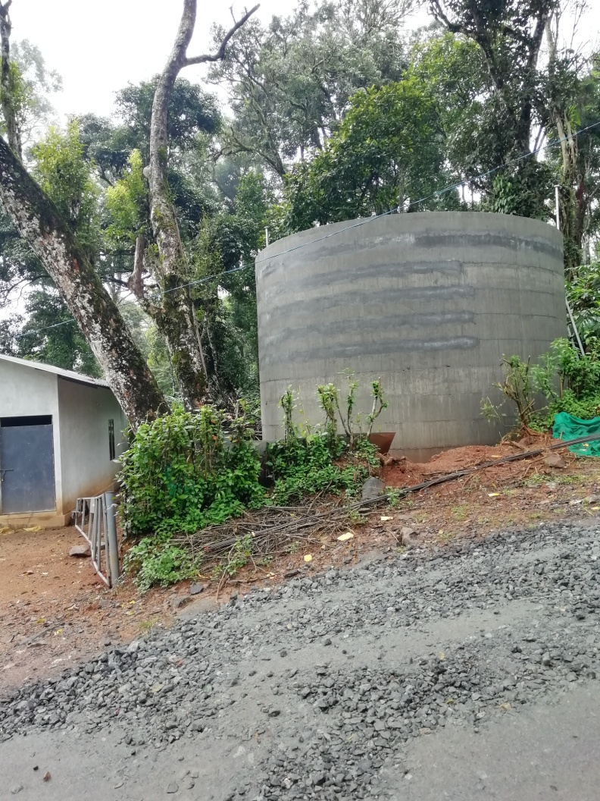
Chromatogram of OW detected with Metalaxyl

Slide 47
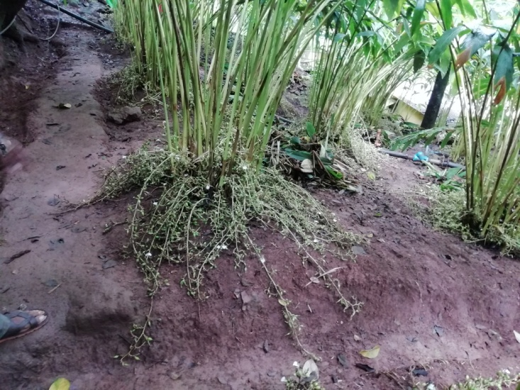
Chromatogram of OW detected with Phenthoate

Slide 48
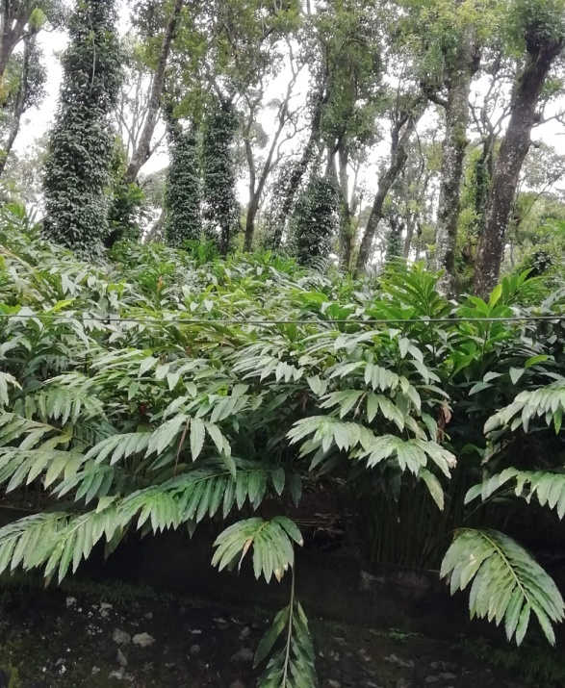
Objective -2
Conduct unsaturated soil column studies under controlled and field conditions using lysimeter to study the mobility of different classes of pesticides through the soil

Slide 49
Soil Lysimeter (inverted position)

Slide 50
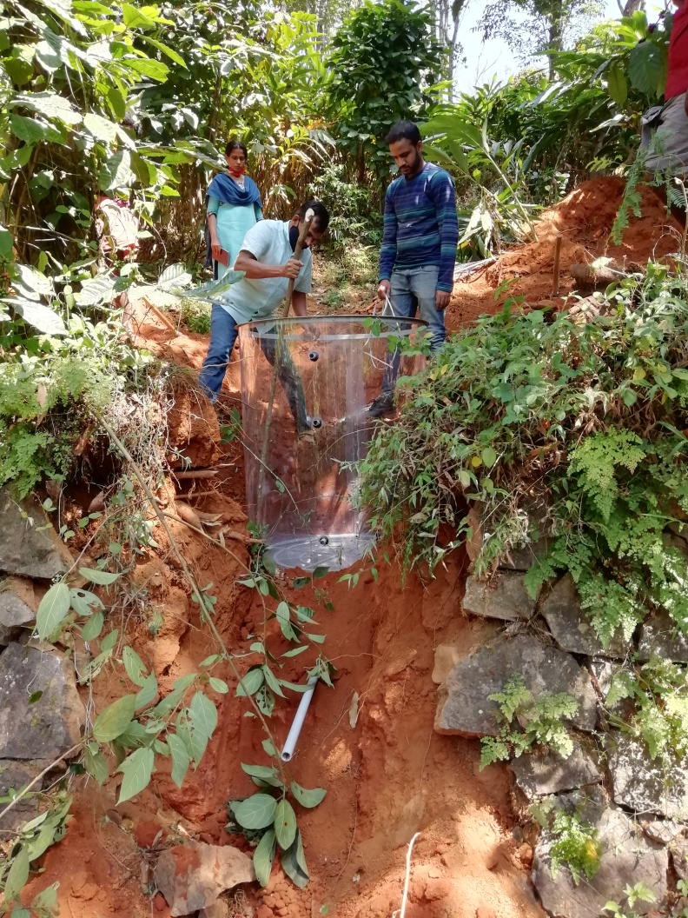
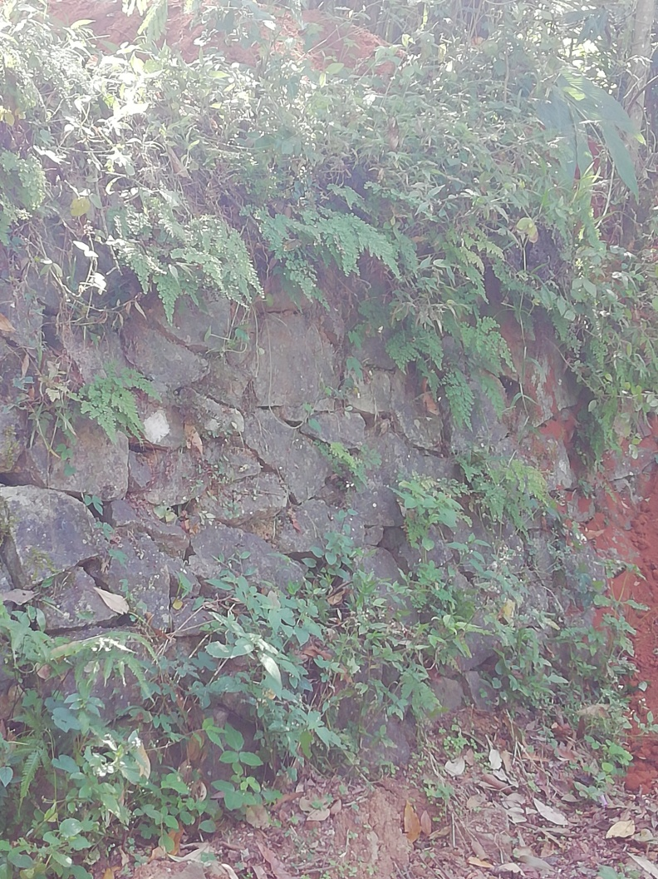
Installation site Installation of lysimeter

Slide 51
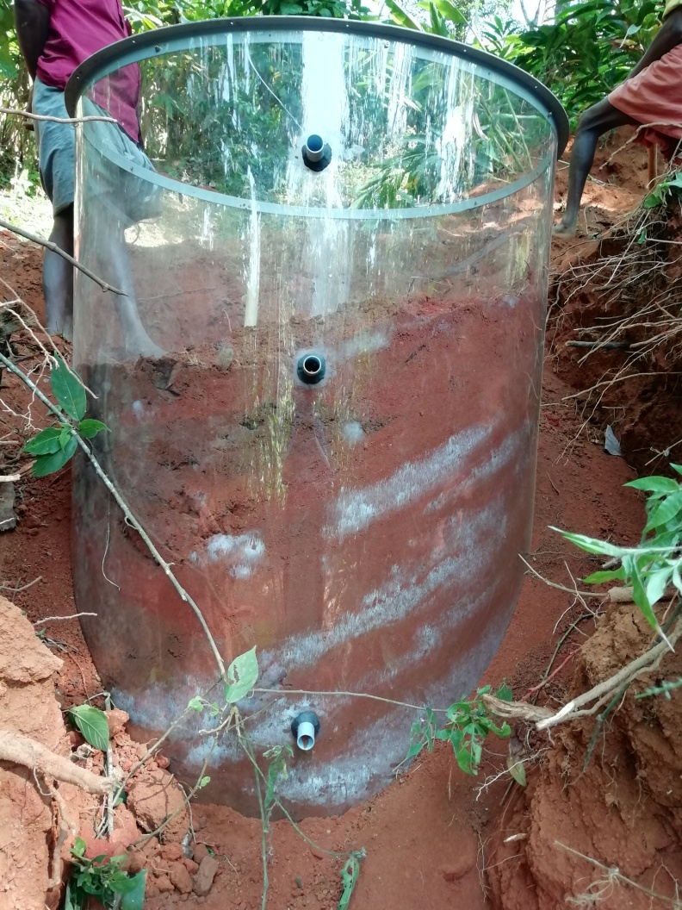
Soil Lysimeter-filling

Slide 52
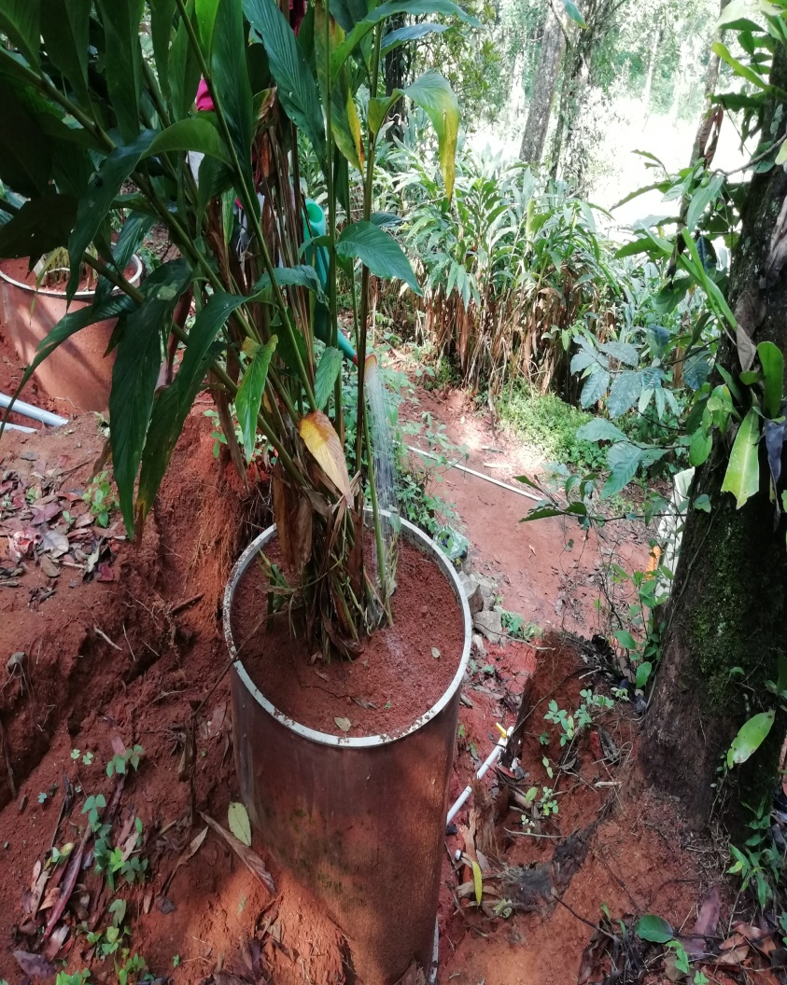
Planting cardamom plant

Slide 53
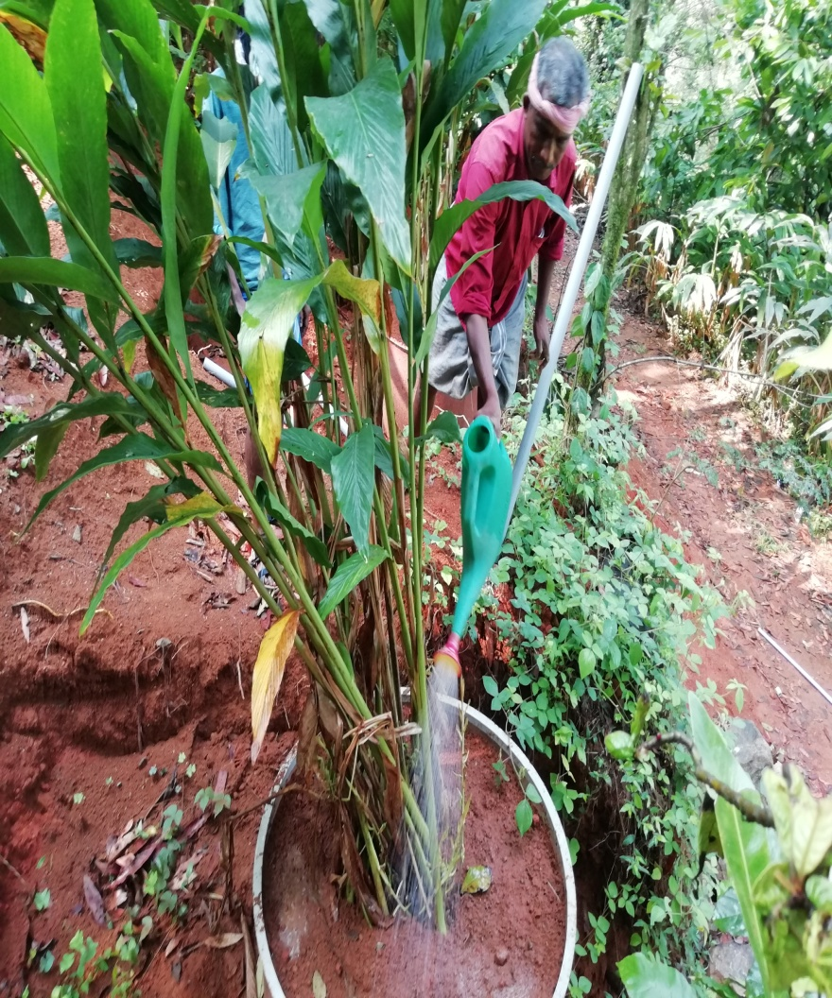
Preparation & application of pesticide solution

Slide 54
Collection of leachate

Slide 55
List of pesticides under investigation
Quinalphs | metalaxyl | Carbendazim | Chlorantraniliprole | Imidachloprid
Diafenthiuron | Fipronil | Lamdda -Cyhalothrin | Carbofuran | Mancozeb

Slide 56
Financial progress (2020 July-December)
Sr. no | Activity | Total Expenditure incurred | comments (if any)
1 | Remuneration/Emoluments for Manpower
2 | Travelling expenditure
3 | Infrastructure and equipments
4 | Experimental charges/ field work/consumables
5 | Contingency

